Slide 1
MOOD MELODY: EMOTION DETECTION AND MUSIC PLAYER SYSTEM
Presented to:
Dr. Hubert A. Johnson
CSIT 515 Software Engineering & Reliability
Spring 2024

Slide 2
TEAM MEMBERS
LAXMI KEERTHI REDDY GANUTHALA
LOKESHWAR REDDY VARRA
SHIVA REDDY ONTELA
VAISHNAVI LOLLA

Slide 3

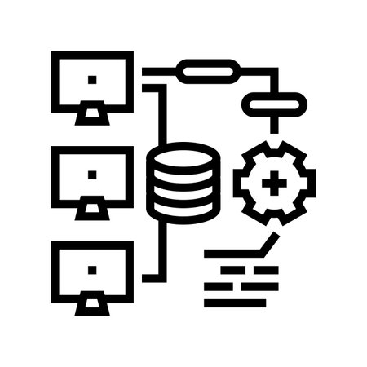
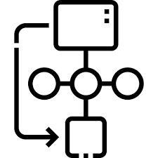



AGENDA
INTRODUCTION
SYSTEM ARCHITECTURE
UML DIAGRAMS
MODULES
SYSTEM REQUIREMENTS
CONCLUSION & FUTURE ENCHANEMENT

Slide 4
INTRODUCTION
Our Project is about the intersection of emotion and technology—our Facial Recognition and Music Player System. This system is not just about playing music; it's about understanding your emotional state through music. Imagine a device that doesn't just play songs but responds to how you're feeling at the moment. Whether you're elated, somber, or somewhere in between, our system detects your current mood through facial recognition and selects music that aligns with emotions. It's designed to offer a personalized audio experience that adjusts to your feelings, aiming to either resonate with your emotional landscape. The core of this system is its ability to intuitively connect with users by recognizing subtle facial expressions and translating them into a musical language that speaks directly to the heart. It's about creating a soundtrack for your life that's dynamically crafted just for you, every moment of the day.

Slide 5
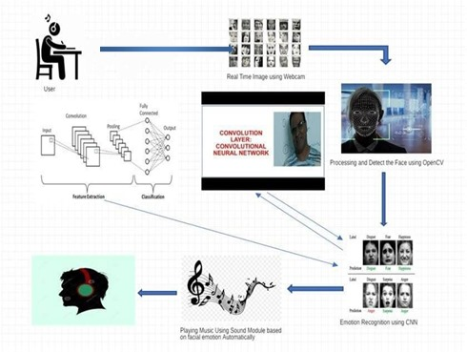
SYSTEM ARCHITECTURE
User
Real – Time Image Using Webcam
Algorithm – CNN
Processing and Detecting the Face using OpenCV
Emotion Recognition Using CNN
Playing Music Based on Facial Mood

Slide 6
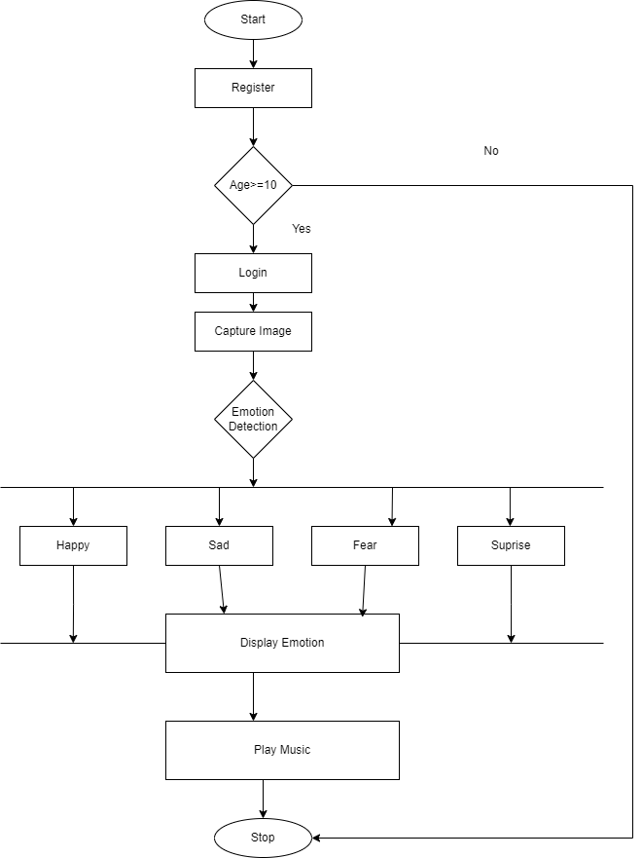
FLOWCHART
The flowchart outlines the operational sequence of an emotion detection and music play system, beginning with user interaction and registration. Once registered and age-verified, users log in and their facial expressions are captured for emotion detection. The system then processes these images to determine the user's emotional state, offering outcomes such as happiness, sadness, anger, neutrality, fear, or surprise. After displaying the detected emotion to the user, the system selects and plays music that matches the identified emotional state. This implies a pre-existing database linking emotions to specific music selections. Finally, users have the option to stop the music, concluding the process. This system aims to enhance user experience by dynamically adapting music to users' emotional cues, potentially offering therapeutic or mood-enhancing benefits.

Slide 7
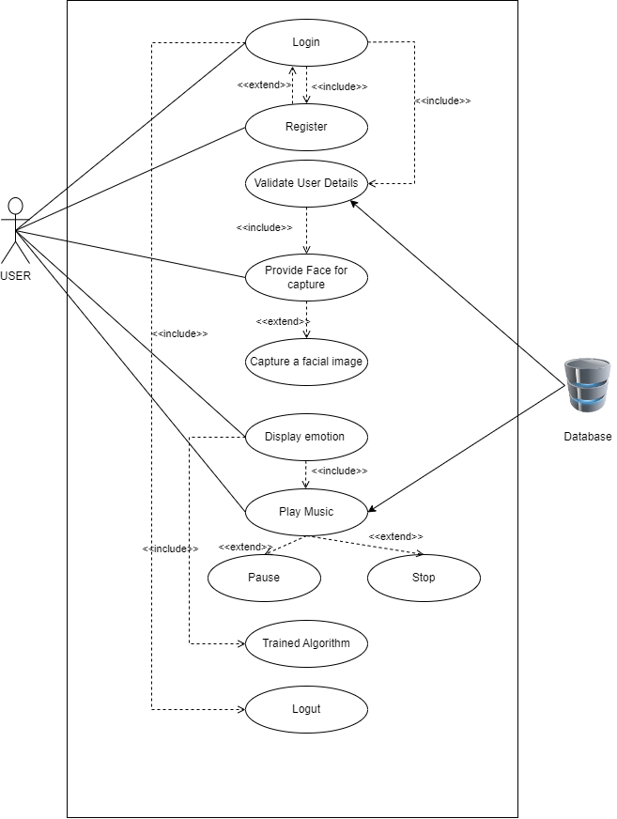
UML DIAGRAMS USECASE DIAGRAM
The use case diagram outlines the interactions between the User actor and the Music Database within the facial recognition and music player system. Users initiate actions such as registration, login, and providing facial images for analysis. The system validates user information, captures facial images, and analyzes them to determine mood, displaying the result to the user. Based on the detected mood, the system retrieves and plays music from the database. Users can control music playback and securely logout when finished. Behind the scenes, a trained algorithm performs facial recognition and mood analysis, enabling personalized music recommendations. This system seamlessly integrates user interactions with database functionality to deliver a tailored and secure music listening experience based on facially recognized emotions.

Slide 8
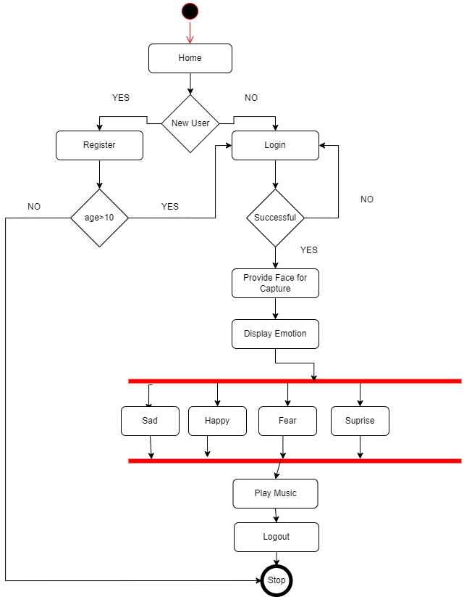
ACTIVITY DIAGRAM
The user experience begins with logging in, where returning users input their credentials, undergo a verification process, and upon successful authentication, proceed to the next step. Post-login, users provide a facial image, captured by a camera, for emotion recognition. The system then interprets the emotion using facial recognition algorithms, selecting mood-appropriate music from a database for playback. The music continues until the user either manually stops it or logs out, ensuring a personalized and immersive experience. Upon logout, the active session securely closes, marking the end of the user's interaction within the system, allowing them to either start anew or exit entirely. Throughout, user actions prompt system responses, ensuring a seamless and secure service flow.

Slide 9
MODULES
USER LOGIN
USER REGISTRATION
FACE DETECTION
EMOTION RECONGINTION
MUSIC PLAYER

Slide 10

SYSTEM REQUIREMENTS
SOFTWARE REQUIREMENTS
Programming Languages – Python
Web Framework – Flask
Algorithm – Convolutional Neural Networks
Database – MySQL
Web Technologies – HTML, CSS, and Javascript

Slide 11
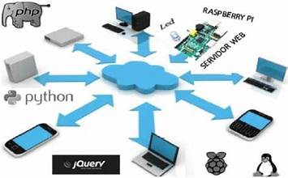
HARDWARE REQUIREMENTS
Server – Multi-core CPU, 8GB RAM, 50 GB storage
User Device – Webcam
Network – High-speed Internet

Slide 12
CONCLUSION
The development of facial recognition and music player system successfully demonstrates the integration of cutting-edge technologies such as convolutional neural networks, Flask, TensorFlow, and more to create a user-centric platform. This system effectively recognizes users' emotions through facial expressions and responds by playing mood-appropriate music, enhancing the user experience through personalization.

Slide 13
FUTURE ENCHANCEMENT
Mood Transition Playlists: Implement an algorithm that doesn't just match the current mood but also curates a playlist designed to transition the user's mood from one state to another. For example, if a user is detected as sad, the system could start with soothing songs and gradually move to more upbeat tracks to gently lift their spirits.
User Feedback Learning: Integrate machine learning algorithms that learn from user feedback. If a user skips or changes songs frequently, the system would learn their preferences and adjust future selections to better match their tastes.
Playlist Customization: Give users the ability to customize playlists, such as adding or removing songs from the automated selections, saving favorites, and creating mood-based playlists that they can name and share.
Advanced Music Controls: Introduce features such as song rewind, fast forward, shuffle, and repeat, giving users more control over their listening experience.

Slide 14
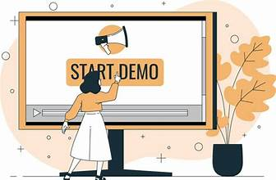
DEMO

Slide 15


Slide 16
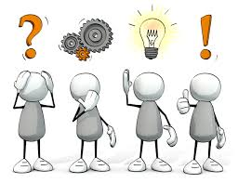
QUESTIONS?

